Slide 1
Weirdest/Interesting Patents in Electronics
Edward Wall

Slide 2
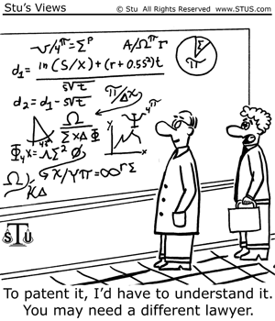
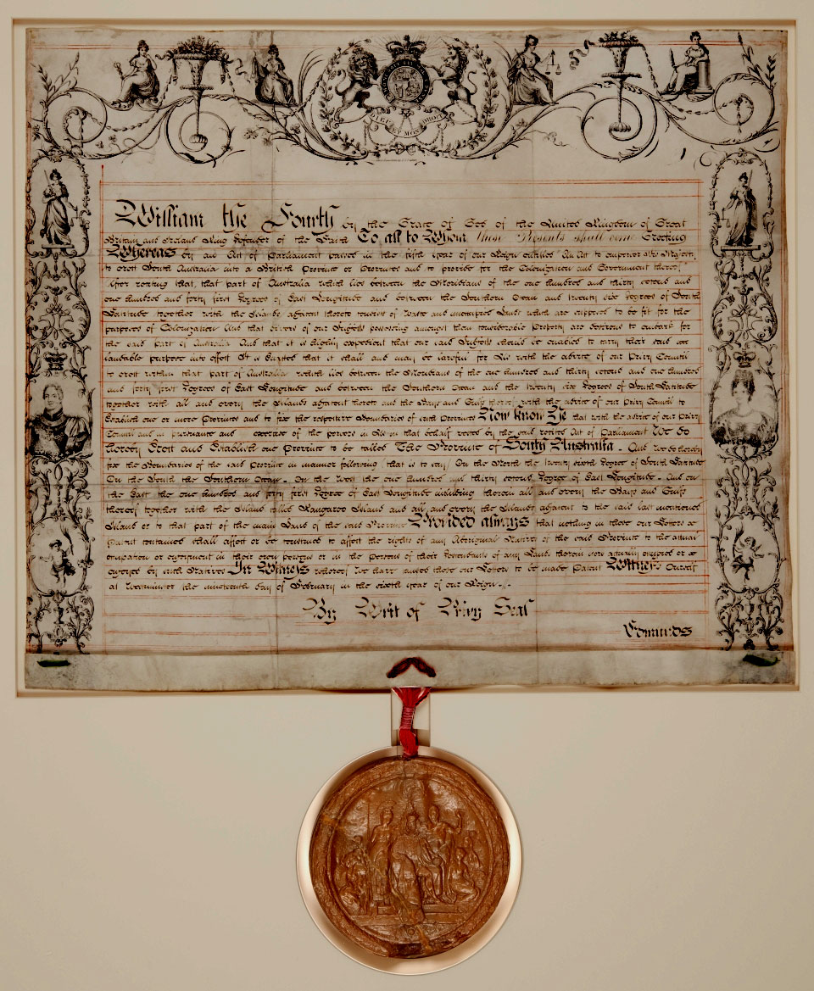
What is a Patent?
A right granted for any device, substance, method or process that is new and inventive
It gives the owner the legally enforceable right to commercially exploit this invention
Requires the filing party to disclose the details of how an invention works
Interestingly items deemed to be non-useful inventions can not be patented. This quite specifically includes Perpetual Motion Machines
Notes:
Filing for a patent has the downside that you must disclose to the public how the invention work. From a research standpoint this could potentially advance another companies efforts even though you retain commercial rights.
Most patents last for 20 years. This is standard in both Australia and America. There are particular patents however that may last for a different amount of time though normally no longer than 25 years.
If an invention is demonstrated or sold in public before filing for a patent it may result in the application being declined. This is generally why confidentiality agreements are so important.
What can be patented
Process
Machine
Article of Manufacture
Composition of Matter
Improvement of any of the above
What can’t be patented
Laws of nature
Physical phenomena
Abstract ideas
Literary, dramatic, musical and artistic works
Not useful inventions (such as perpetual motion motions)
Inventions that are offensive to public morality
http://www.ipaustralia.gov.au/get-the-right-ip/patents/about-patents/
http://www.uspto.gov/inventors/patents.jsp

Slide 3
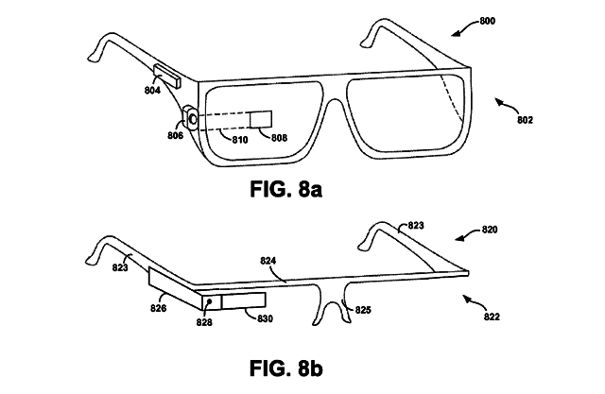
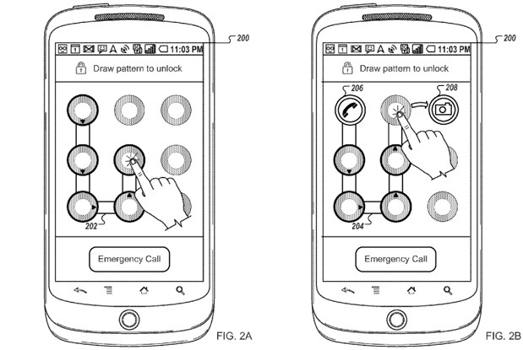
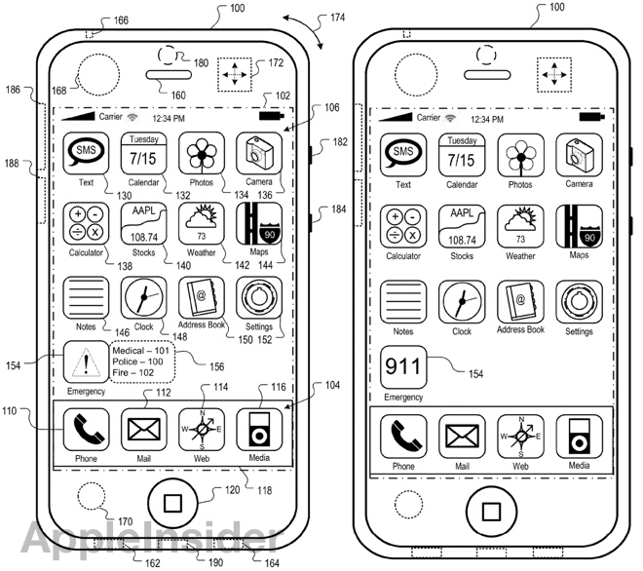
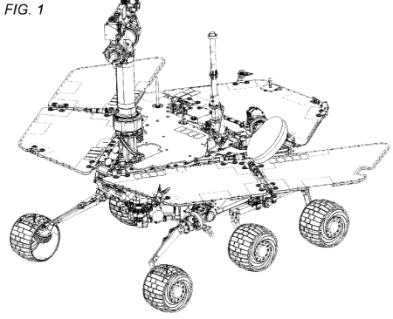
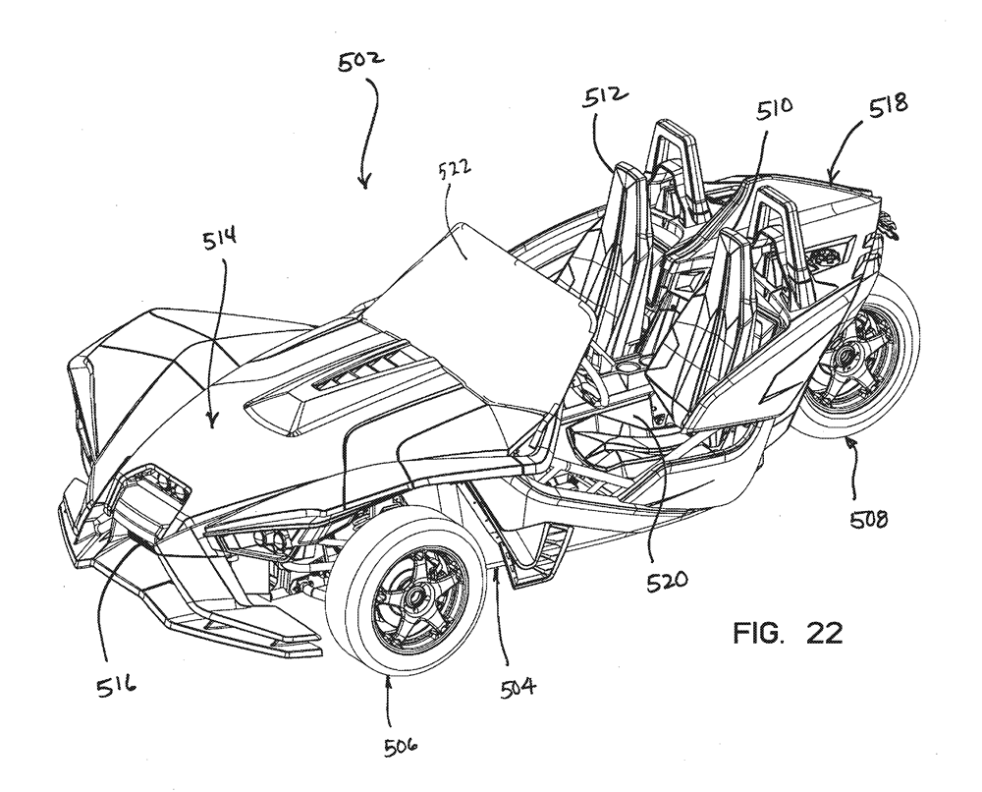
Items Patented in the Tech World
What can be patented
Process
Machine
Article of Manufacture
Composition of Matter
Improvement of any of the above
Notes:
The patent for Google Glass is called Displaying Sound Indications on a Wearable Computing System – 2012.
The android patent Alternative Unlocking Patterns – 2013 is an extension of the current locking pattern scheme that allows the system to unlock directly to an app based on the final position.
Perhaps the most interesting item here is the Mars Exploration Rover Athena – 2004. The Original Assignee for this is the California Institute of Technology.
The vehicle is the Polaris Slingshot. It is a patent for a street legal side by side reverse trike.
http://appleinsider.com/articles/13/08/09/the-iphone-patent-wars-early-patent-skirmishes-of-apple-inc-in-pictures
http://thekneeslider.com/polaris-patent-reveals-a-side-by-side-three-wheeler/
http://ausdroid.net/2013/08/07/new-google-patent-shows-customisable-pattern-unlock-to-apps/
http://www.google.com.au/patents/US8183997
http://www.google.com/patents/USD487715#v=onepage&q&f=false

Slide 4
Why do I care about Patents?

Slide 5

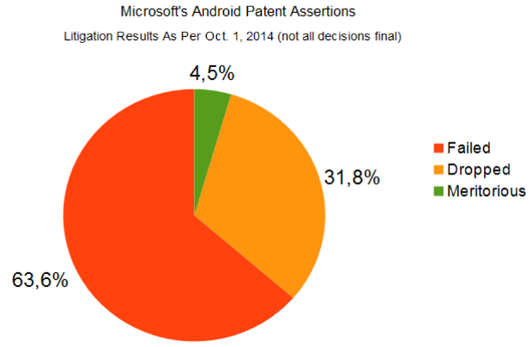
Big Money Patents
Microsoft made $3.4 Billion in Android patents alone
Samsung had to pay $1 Billion
Motorola however has been actively fighting these claims. They have won most of the individual cases
Notes:
Why do I care about Patents?
Microsoft’s Billion Dollar a year Samsung Deal
Microsoft and many other large tech companies actually make a lot of money from patent deals which allow other companies to make use of there intellectual property.
In 2013 Microsoft made $3.4 billion dollars from android patents alone with a billion dollars from its Samsung Android patent licensing deal. Interestingly most of Microsoft’s android cases don’t result in payout.
Interestingly Motorola has fought Microsoft’s patents in court and seems to be winning with 16 out of 17 cases being won by Motorola.

Slide 6
Strange Patents

Slide 7
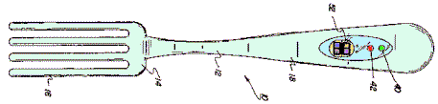
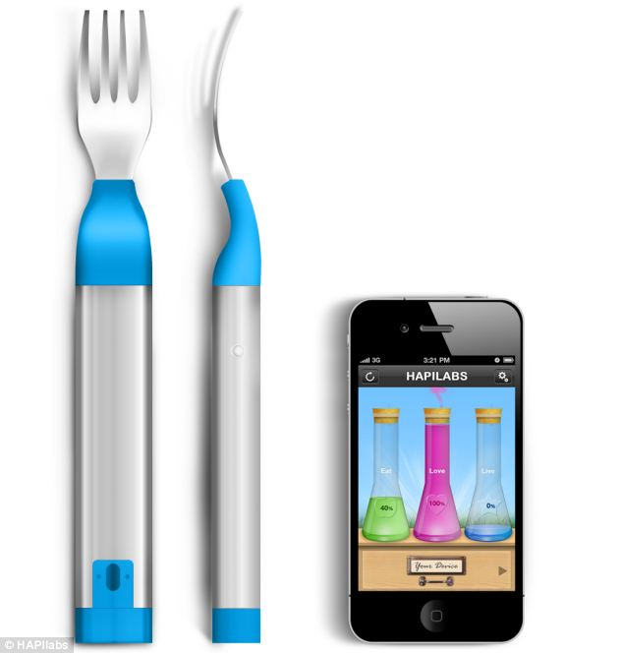
Alarm Fork – A method for slower eating
Conceived with the intention of combatting gluttony
Sensor is triggered when the user has a bite to eat
Light will remain red until a set time has passed
When the light turns green the user can again continue eating
Patent #5421089 – 1995
Notes:
US Patent #5421089 issued in 1995
Based on the idea that eating more slowly your body realises it is full much sooner this fork was conceived with the intention of combatting obesity.
Interestingly this idea is being revamped as in the second image. This is Hapilabs fork which wirelessly transmits details about how fast the user is eating to their phone. This fork has the added bonus of vibrating if the user is eating to fast as well as flashing a light. This was set to go on sale early last year.
http://totallyabsurd.com/alarmfork.htm (This site has a lot of weird patents)
http://www.dailymail.co.uk/sciencetech/article-2258324/The-60-smart-fork-monitor-eat--sound-alarm-overdo-dessert.html

Slide 8
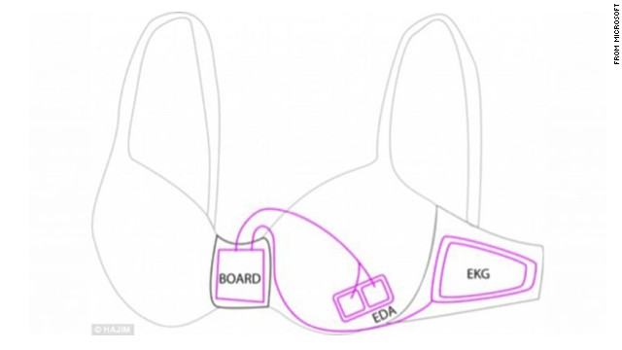
Microsoft Smart Bra
Similar to the last product this item is intended to help combat overeating.
Measures heart rate and skin activity
The analysis is transmitted to a phone app
Helps user determine when they are comfort eating
Notes:
This is referred to as an intelligent undergarment that can detect stress and warn emotional overeaters when they are only eating for comfort.
The device collects data on the wearer’s emotions via removable sensors. The system measures heart rate, skin activity and feeds the analysis back to a phone app.
Currently the system has the downside of needing to be charged every few hours.
http://www.pcauthority.com.au/News/366583,microsoft-patents-smart-bra-design-really.aspx
http://edition.cnn.com/2013/12/04/tech/innovation/microsoft-smart-bra/

Slide 9
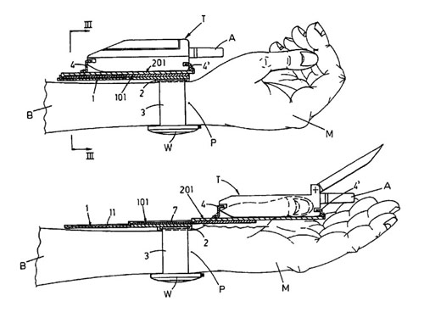
Device for the quick and easy use of a small size cellular telephone – 2004
A device for quick and easy access to ones Mobile
Phone kept on a Telescopic Slide attached to the wrist
Allows the user to easily notice vibrations cause by receiving messages and quickly react.
Notes:
A device that allows a small phone fixed to a telescopic slide to be easily accessed and stored.
The slide allows the phone to slide along a guide to rest within the users hand upon which calls can be conducted normally.
Keeping the phone at the users wrist vibrations are more easily noticed allowing calls and messages to be quickly noticed.
http://www.google.com/patents/US6796467

Slide 10
Communications and Portable Electronics

Slide 11
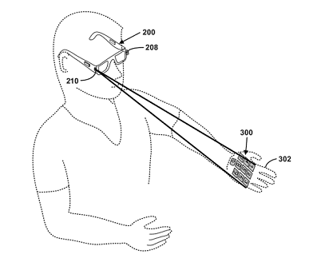
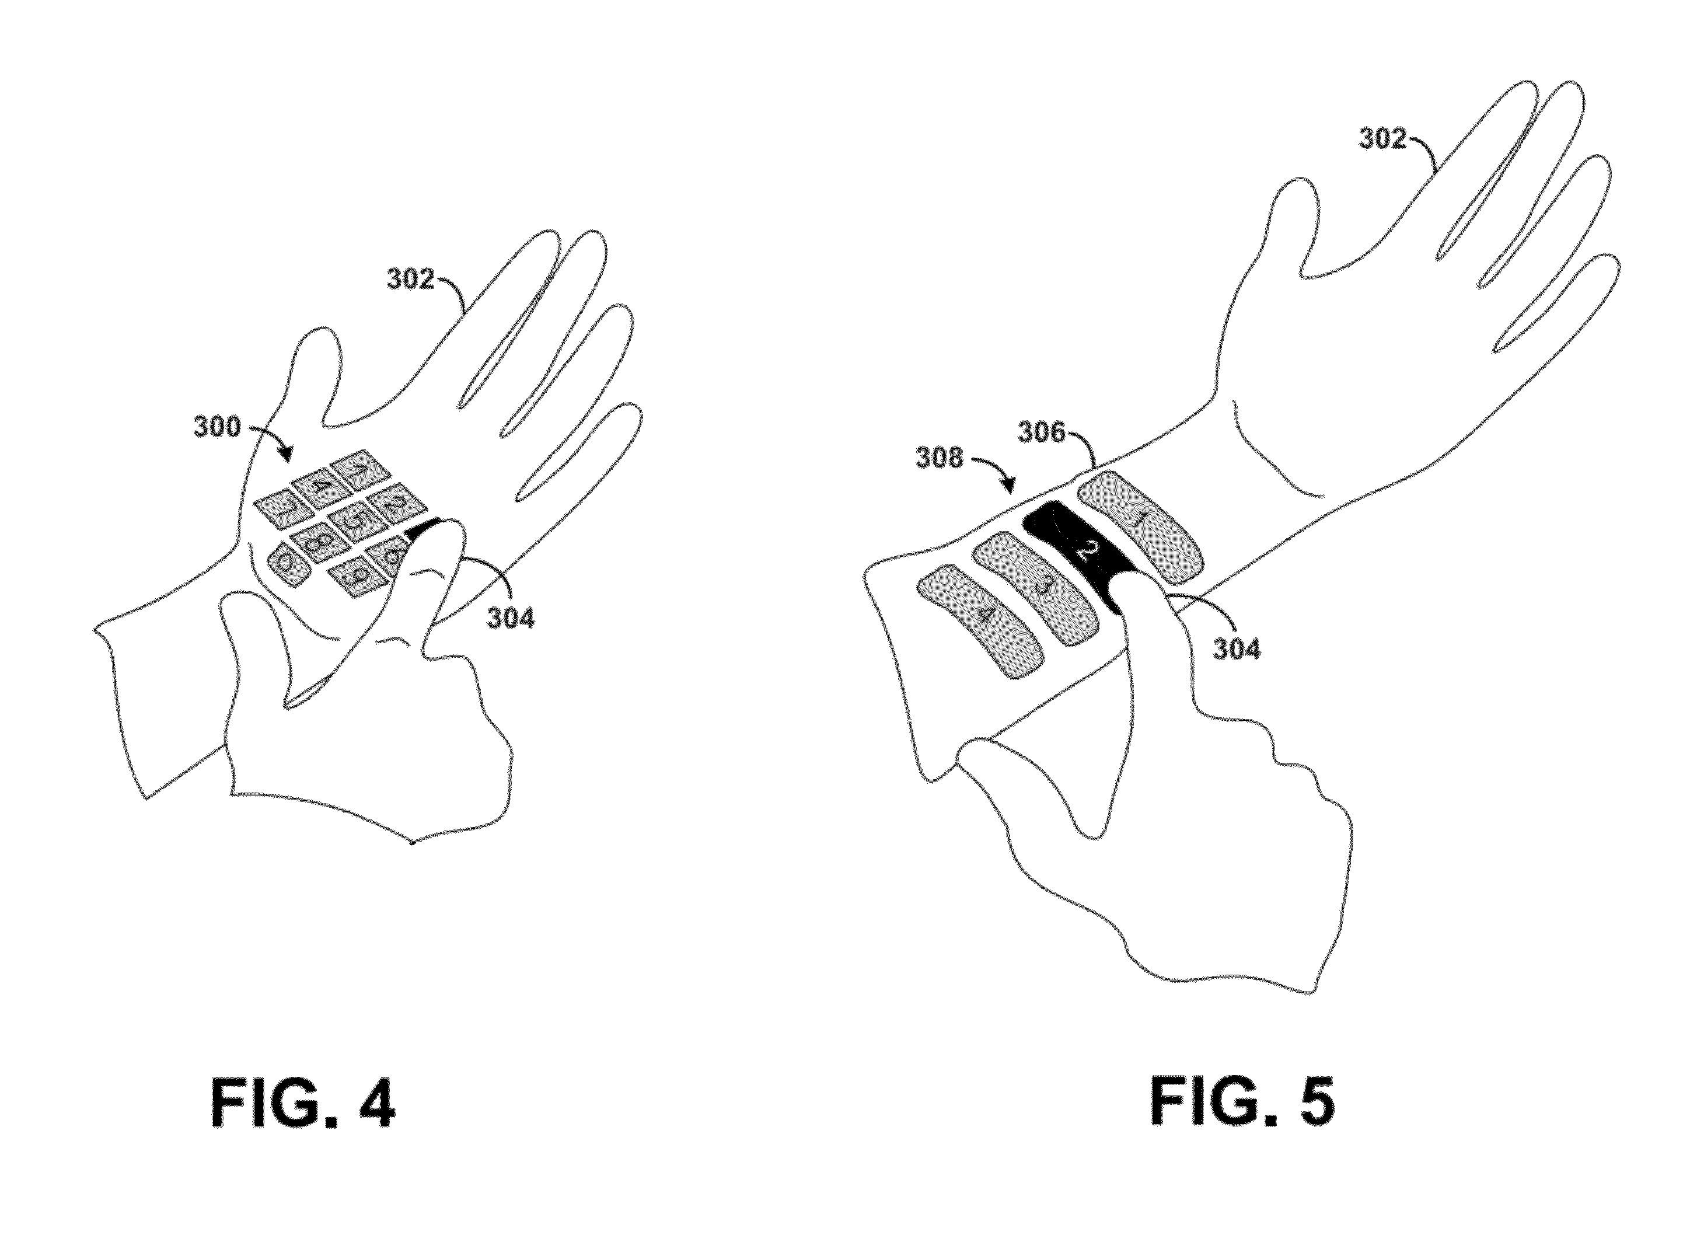
Methods and Systems for a Virtual Input Device – 2013
Makes use of Google Glass
Projects a virtual keyboard
Capable of detecting finger movement translating the movements to keystrokes
Uses a red diode laser for projection
A second projected laser measures keystrokes.
Reflection is broken on keystroke.
Notes:
Patent owned by Google
The keyboard can be projected onto any surface though it is the intention that it will used on one’s own hand or forearm.
Making use of this, one can completely forgo the use of a smartphone instead making use of Google Glasses for sending messages or making calls.
This system removes the problem that voice cues may be misinterpreted by Google Glass in loud areas.
http://www.google.com/patents/US8228315

Slide 12
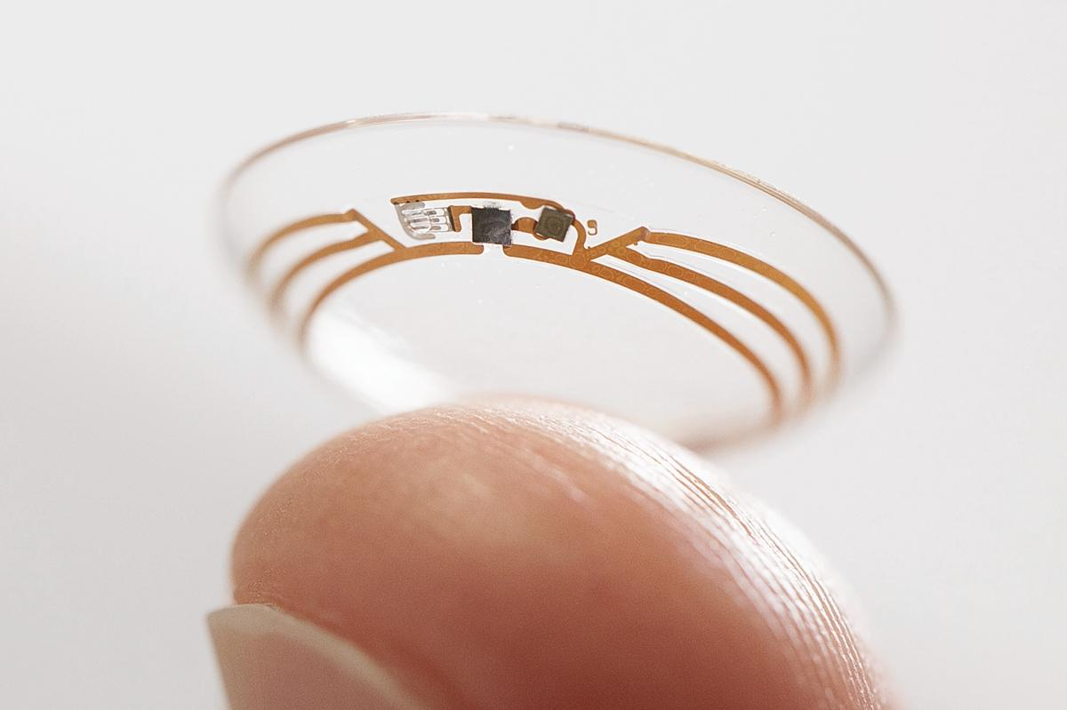
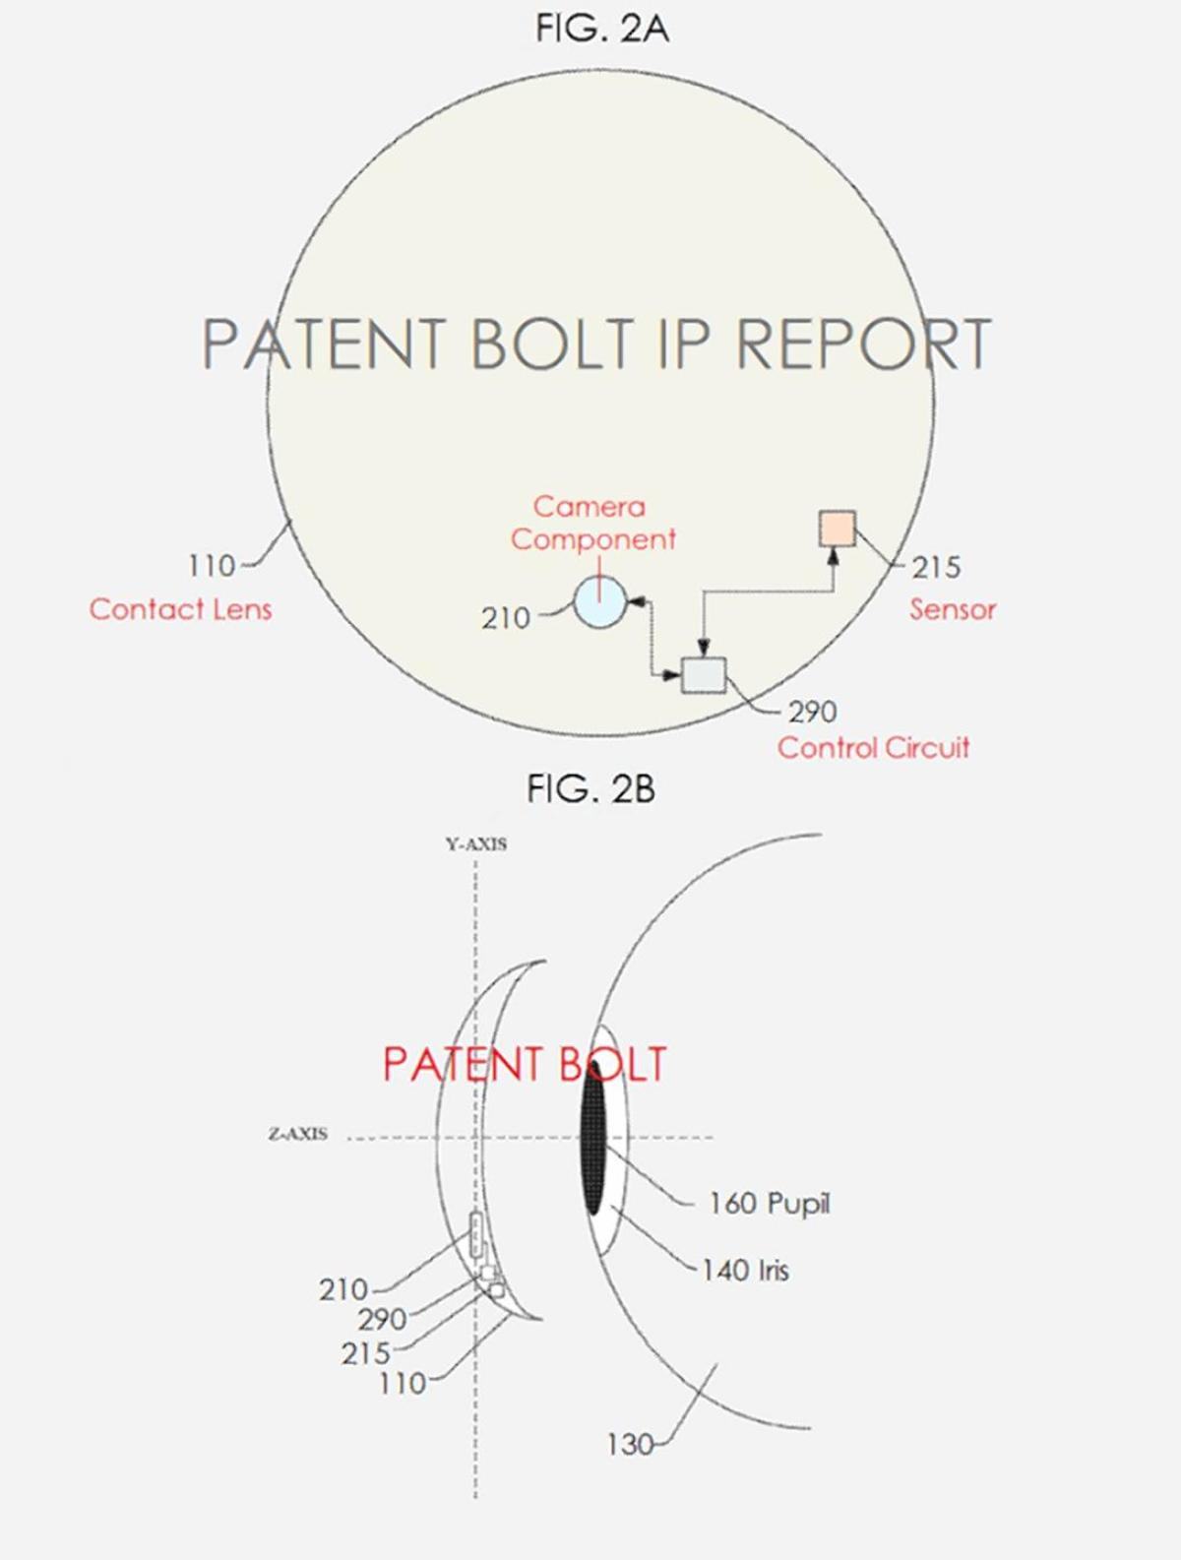
Rumoured Google Glass like Contacts
Similar to Google Glass the lens will contain a small camera allowing video streams or pictures to be taken.
Lens will be controlled with specific blinking patterns signifying different actions
Has particular applications for blind people. Should certain situations be seen on camera the user may be notified.
Notes:
Note the first picture is not actually of this system it is a contact lens that google worked on previously.
It is intended that this system will contain a micro-camera allowing it to perform similarly to the current implementation of Google Glass. The method of controlling the lens is quite different from google glass. Instead of using voice control the system will use a combination of specific blinking patterns.
It is intended that blind people may be able to use the device so that it could warn them of specific situations. For example they may be approaching an intersection.
http://oneherald.com.au/google-patents-smart-contact-lens-system/

Slide 13
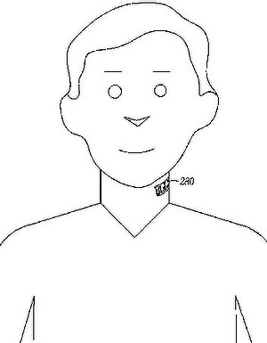
Coupling an Electronic Skin Tattoo to a Mobile Communication Device – 2012
Electronic Skin Tattoo
The intention is that the circuit is attached to the users throat
This system provides easy voice input to a mobile communications device
Circuit includes a microphone and wireless transmitter
Provides an improved signal to noise ratio when using phones
Notes:
This patent was taken out by Motorola Mobility LIc
The electronic tattoo contains an embedded microphone, a transceiver for wireless communication and a power supply.
System is capable of receiving an initiation or energizing signal from a Mobile Communications Device upon which it will initiate reception of an audio stream and transmit it to said device.
It is intended that the system will be charged by these initialisation signals charging a battery within the device. It may therefore involve holding a device to your throat to charge via NFC or Bluetooth.
Main communications with the device will be done with Bluetooth.
http://www.google.com/patents/WO2013166377A1?cl=en

Slide 14
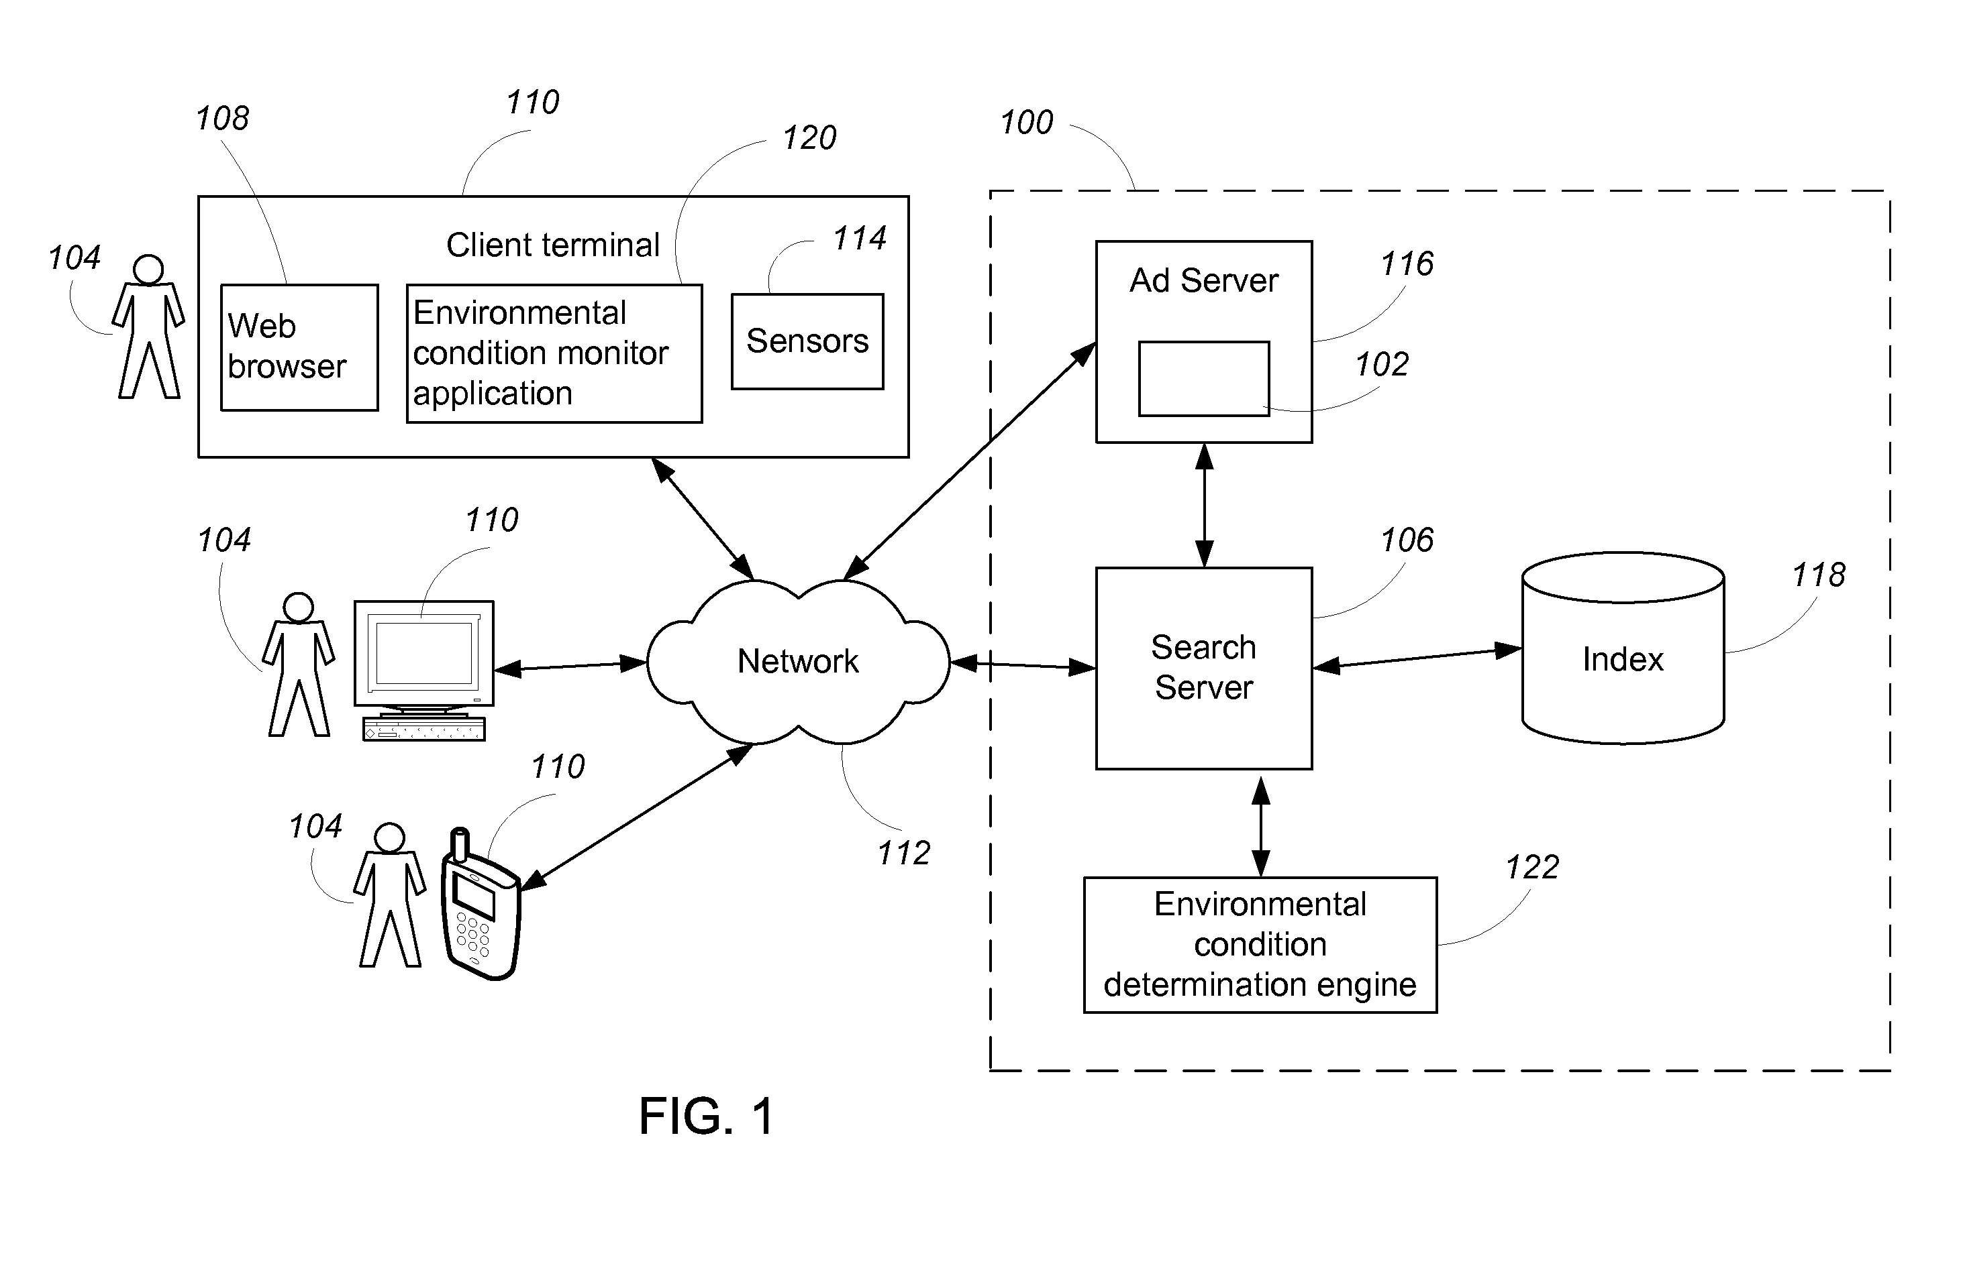
Advertising Based on Environmental Conditions – 2008
This system will equip Mobile Devices with devices capable of measuring
Temperature
Humidity
Sound
Light
Chemical Composition of the air
A modification for advertising algorithms used during search terms will be modified based on aforementioned measurements.
Notes:
When parsing search requests the environmental conditions will be considered.
As an example when one enters a hot dry room one may be directed to more favourable conditions as part of targeted advertising.
Of course this is owned by Google.
http://www.google.com/patents/US8138930

Slide 15
Software and FPGA parallels with Programmable Microfluidics

Slide 16
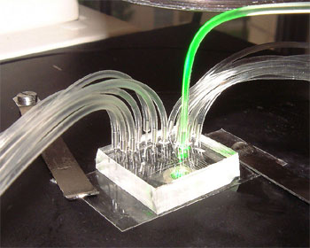
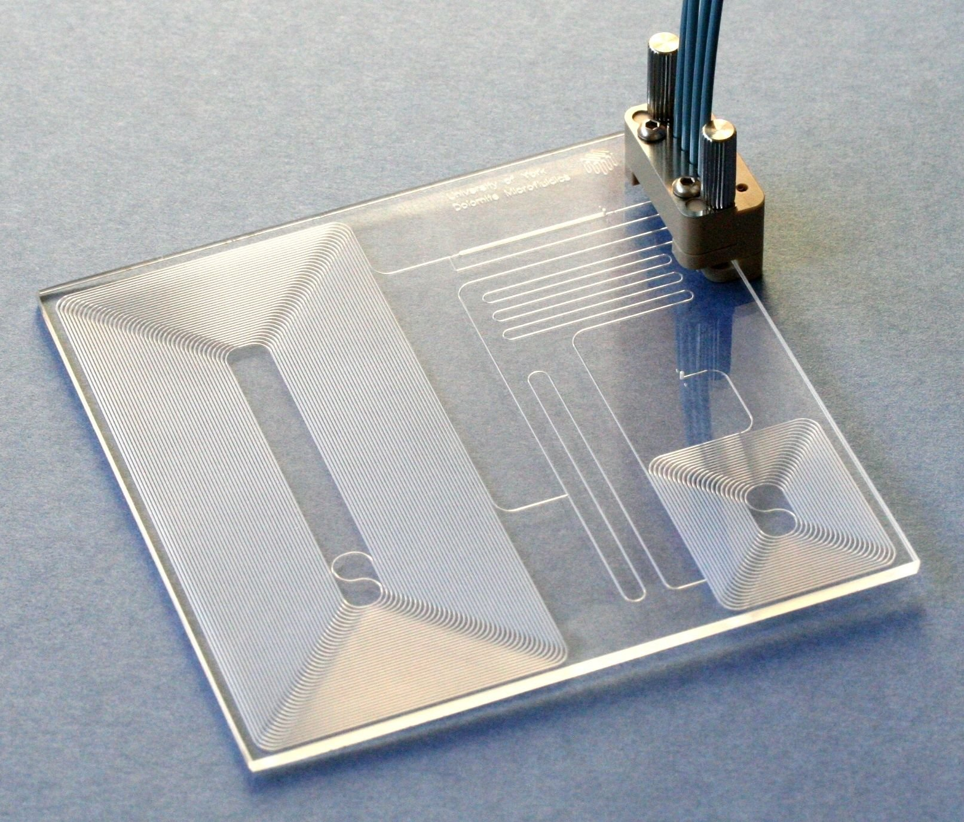
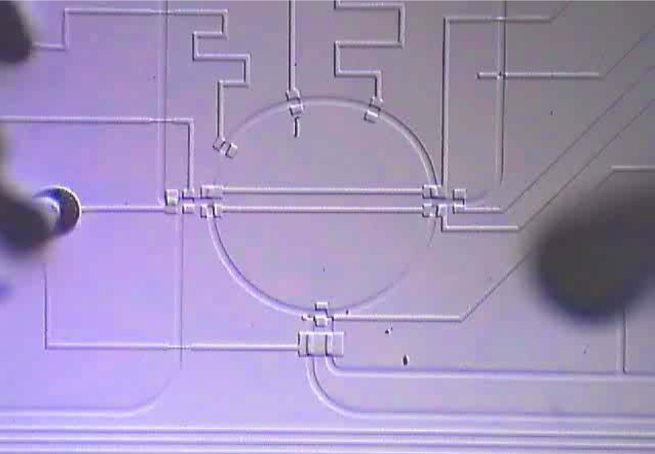
What is a Microfluidic
Technology used by Biologists for mixing minute measures of concentrates. This goes from micrometre down to picometer quantities.
A Microfluidic chip is a set of channels etched into a melded material. In general PDMS is used.
Notes:
An introduction to Microfluidics.
These are basically just plastic like chips with channels etched in them that allow fluid to flow or mix in a prescribed fashion.
At the moment this is mostly equivalent to ASIX chips with the system performing one unchangeable function.
These are often referred to as a Lab on Chip.

Slide 17
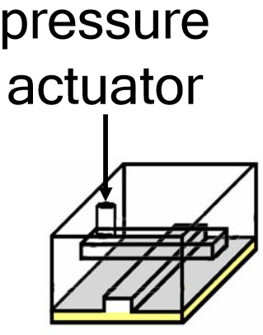
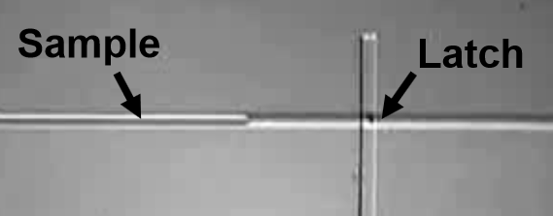
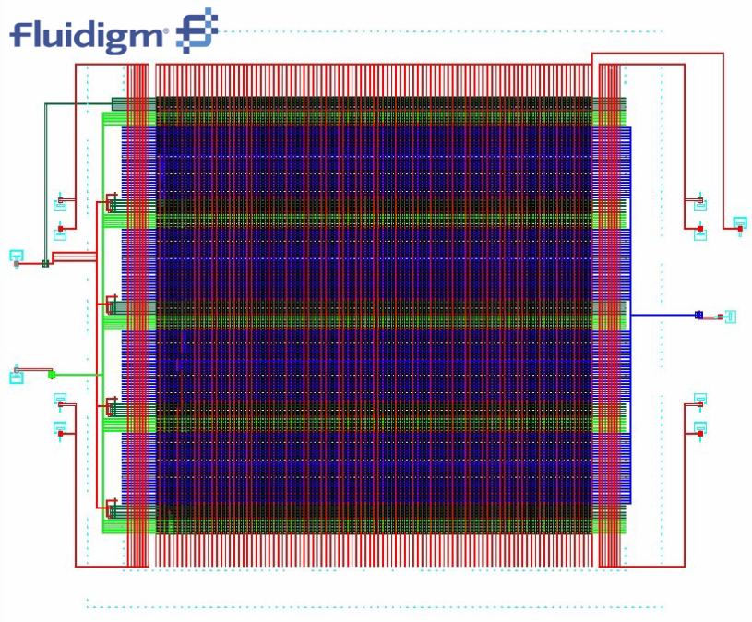
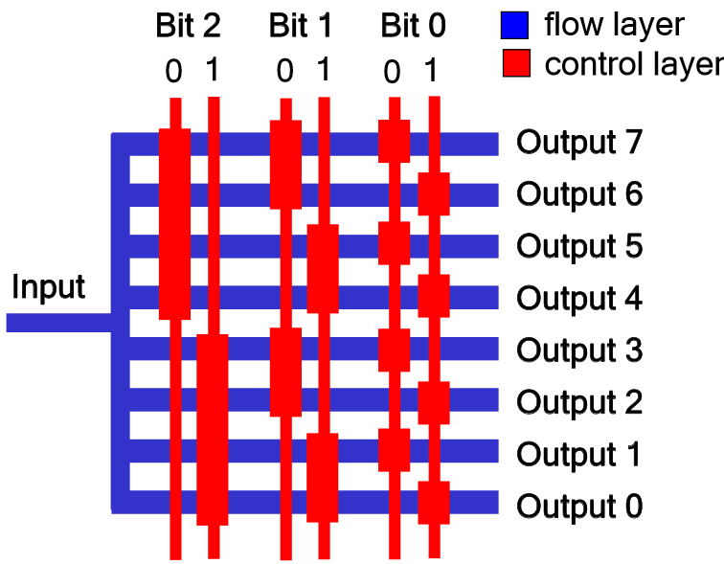
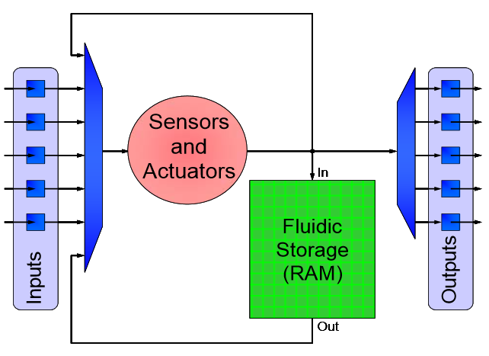
How is this related to electronics??
Primitive Gates such as
Valve (flip flop like)
Multiplexors
Latches
Notes:
The tracks are roughly equivalent electric connections.
The systems can involve Mixers, Latches, Valves and Multiplexors among other primitive structures.
Note the final image is quite similar to an FPGA design with multiple blocks that can be programmed for specific situations.
For more information see Programmable Microfluidics – Bill Thies http://web.stanford.edu/class/ee380/Abstracts/071003-slides.pdf
Computer Science and Artificial Intelligence Laboratory MIT

Slide 18
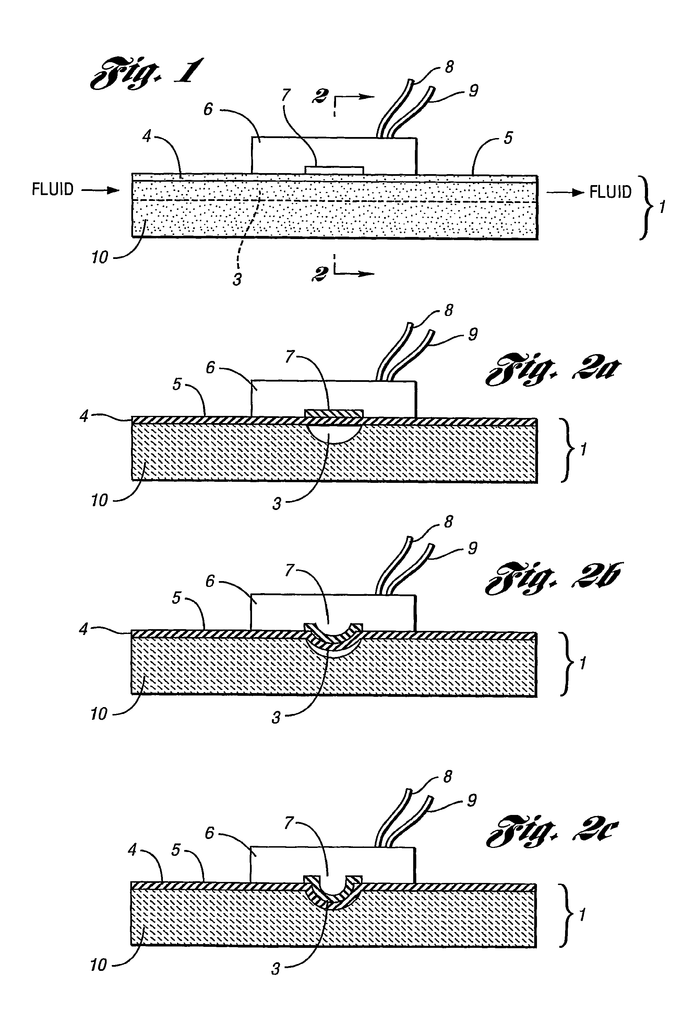
Integrated Microfluidic Control Employing Programmable Tactile Actuators – 2012
System uses a thin elastomeric membrane that can cover tracks
The system is activated by computer driven actuators external to the membrane.
Allows for discrete control over Microfluidics
Notes:
As an extension of this ASIX like design computer scientists are currently attempting to create universal synthesises and compilers allowing these chips to be reprogrammable like FPGAs. This is both being approached with gate level design and with a C like compiler.
It is intended that the actuators would be controlled using pneumatic pumps allowing the membrane to be firmly pressed against the track. This is an electronically addressable tactile actuator.
http://www.google.com/patents/WO2004081741A2?cl=en

Slide 19
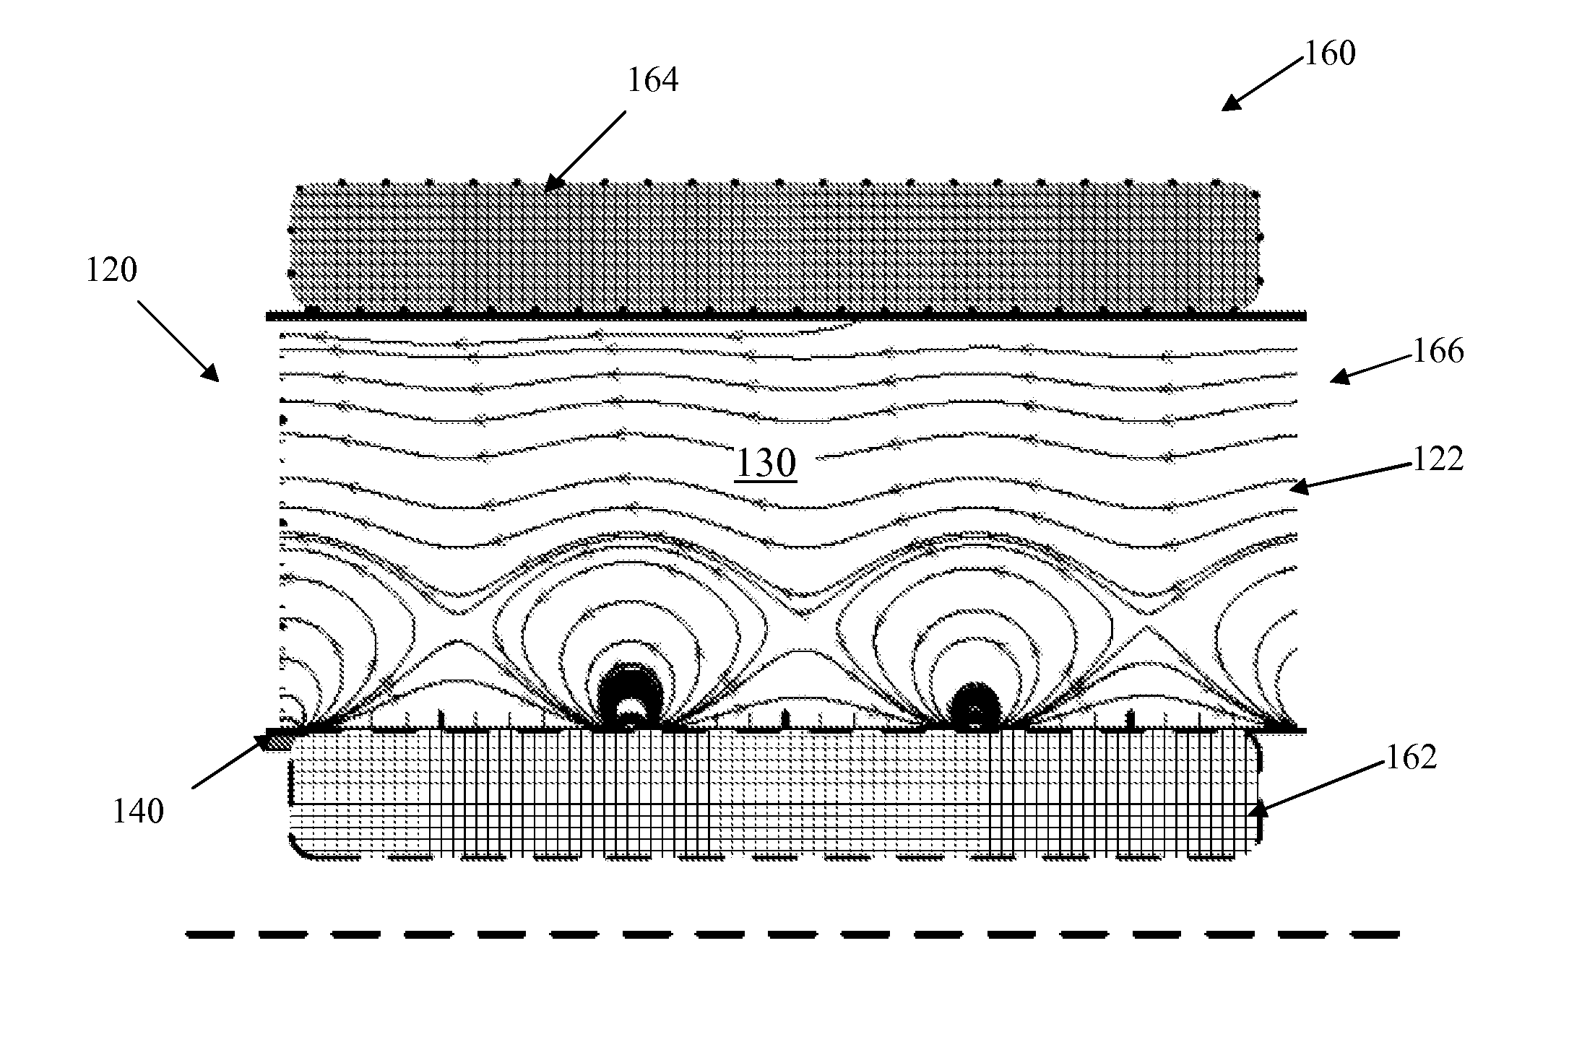
Microfluidic Pumping Based on Dielectrophoresis – 2013
Method for controlling and regulating flow
Generated using microelectrodes
The fluidic driving mechanisms due to particle-fluid and particle-particle interaction are numerically analysed allowing induced flow field to be calculated.
Notes:
As an alternative to the previously presented Tactile Actuators.
Dielectrophoresis is a method by which a force can be exerted on a particle (charged or uncharged) using a non-uniform electric field. It depends strongly on the frequency of field and the properties of the medium.
This system works by using multiple frequency scalable electromagnetic fields. Adjusting the frequency of each field and temporally spacing them by a phase angle the system creates a flowpath.
http://www.google.com.au/patents/US8470151

Slide 20
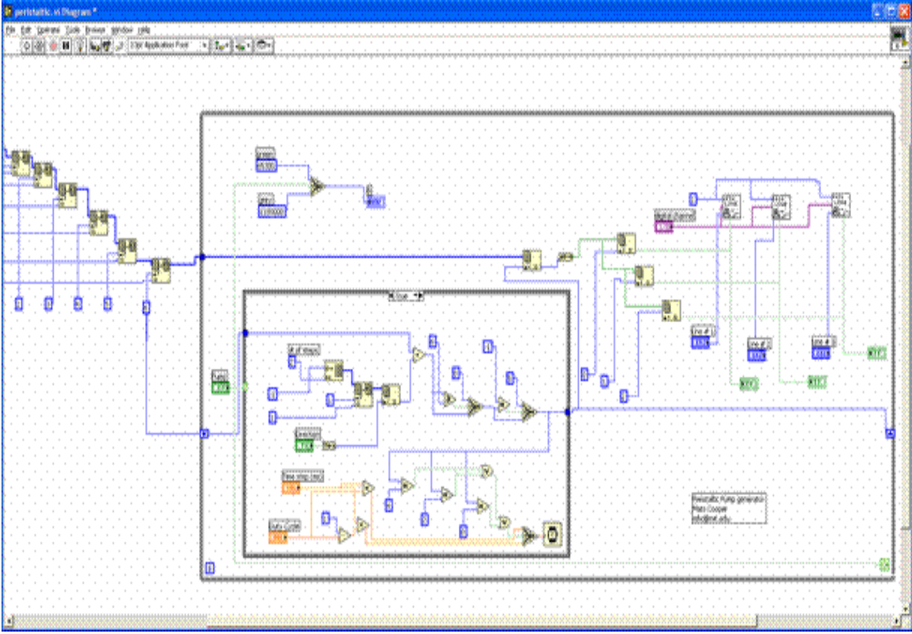
Gate Level Chip Design
Notes:
Note this sought of system has lots of parallels with FPGAs design.
Particular caution has to be taken when setting up timing.

Slide 21
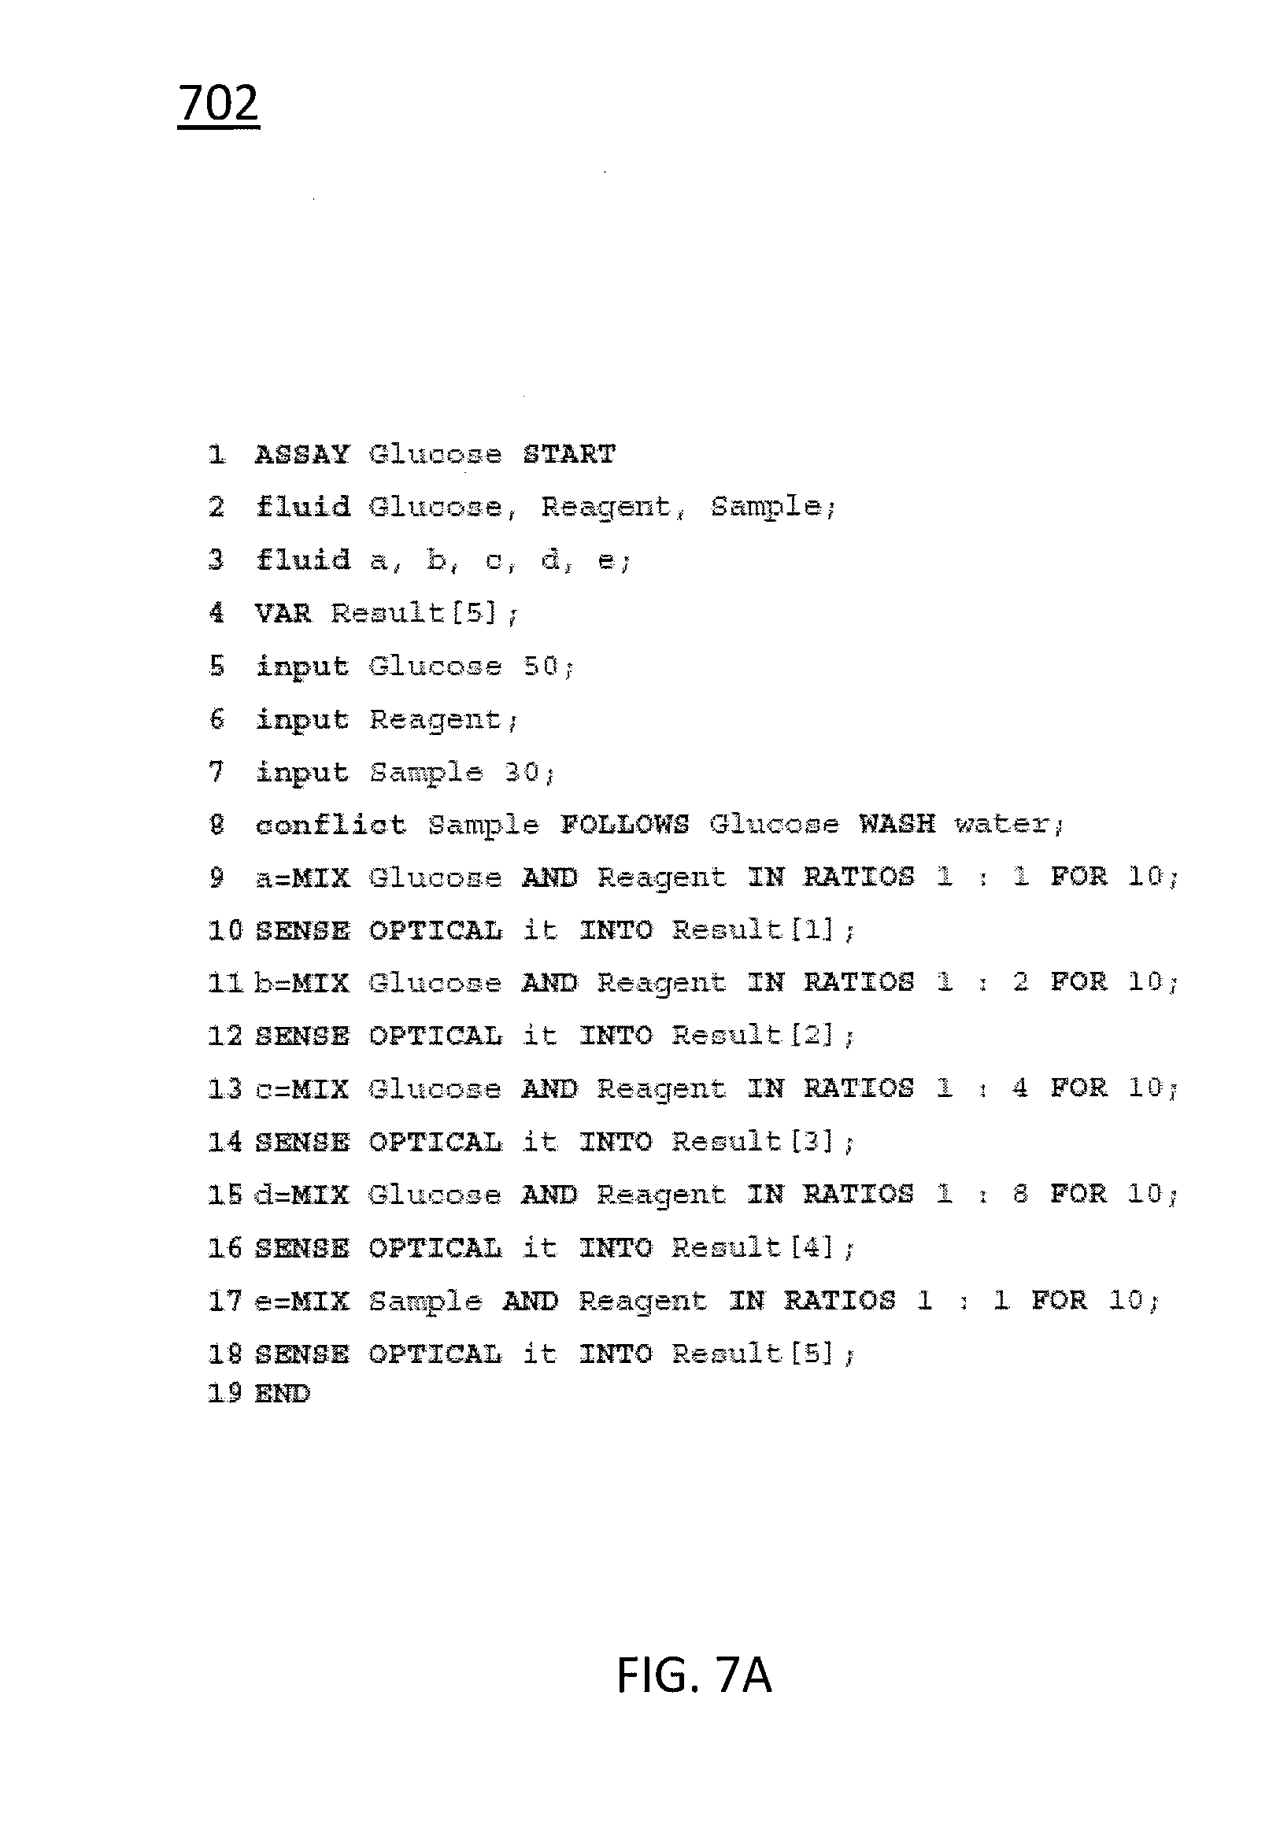
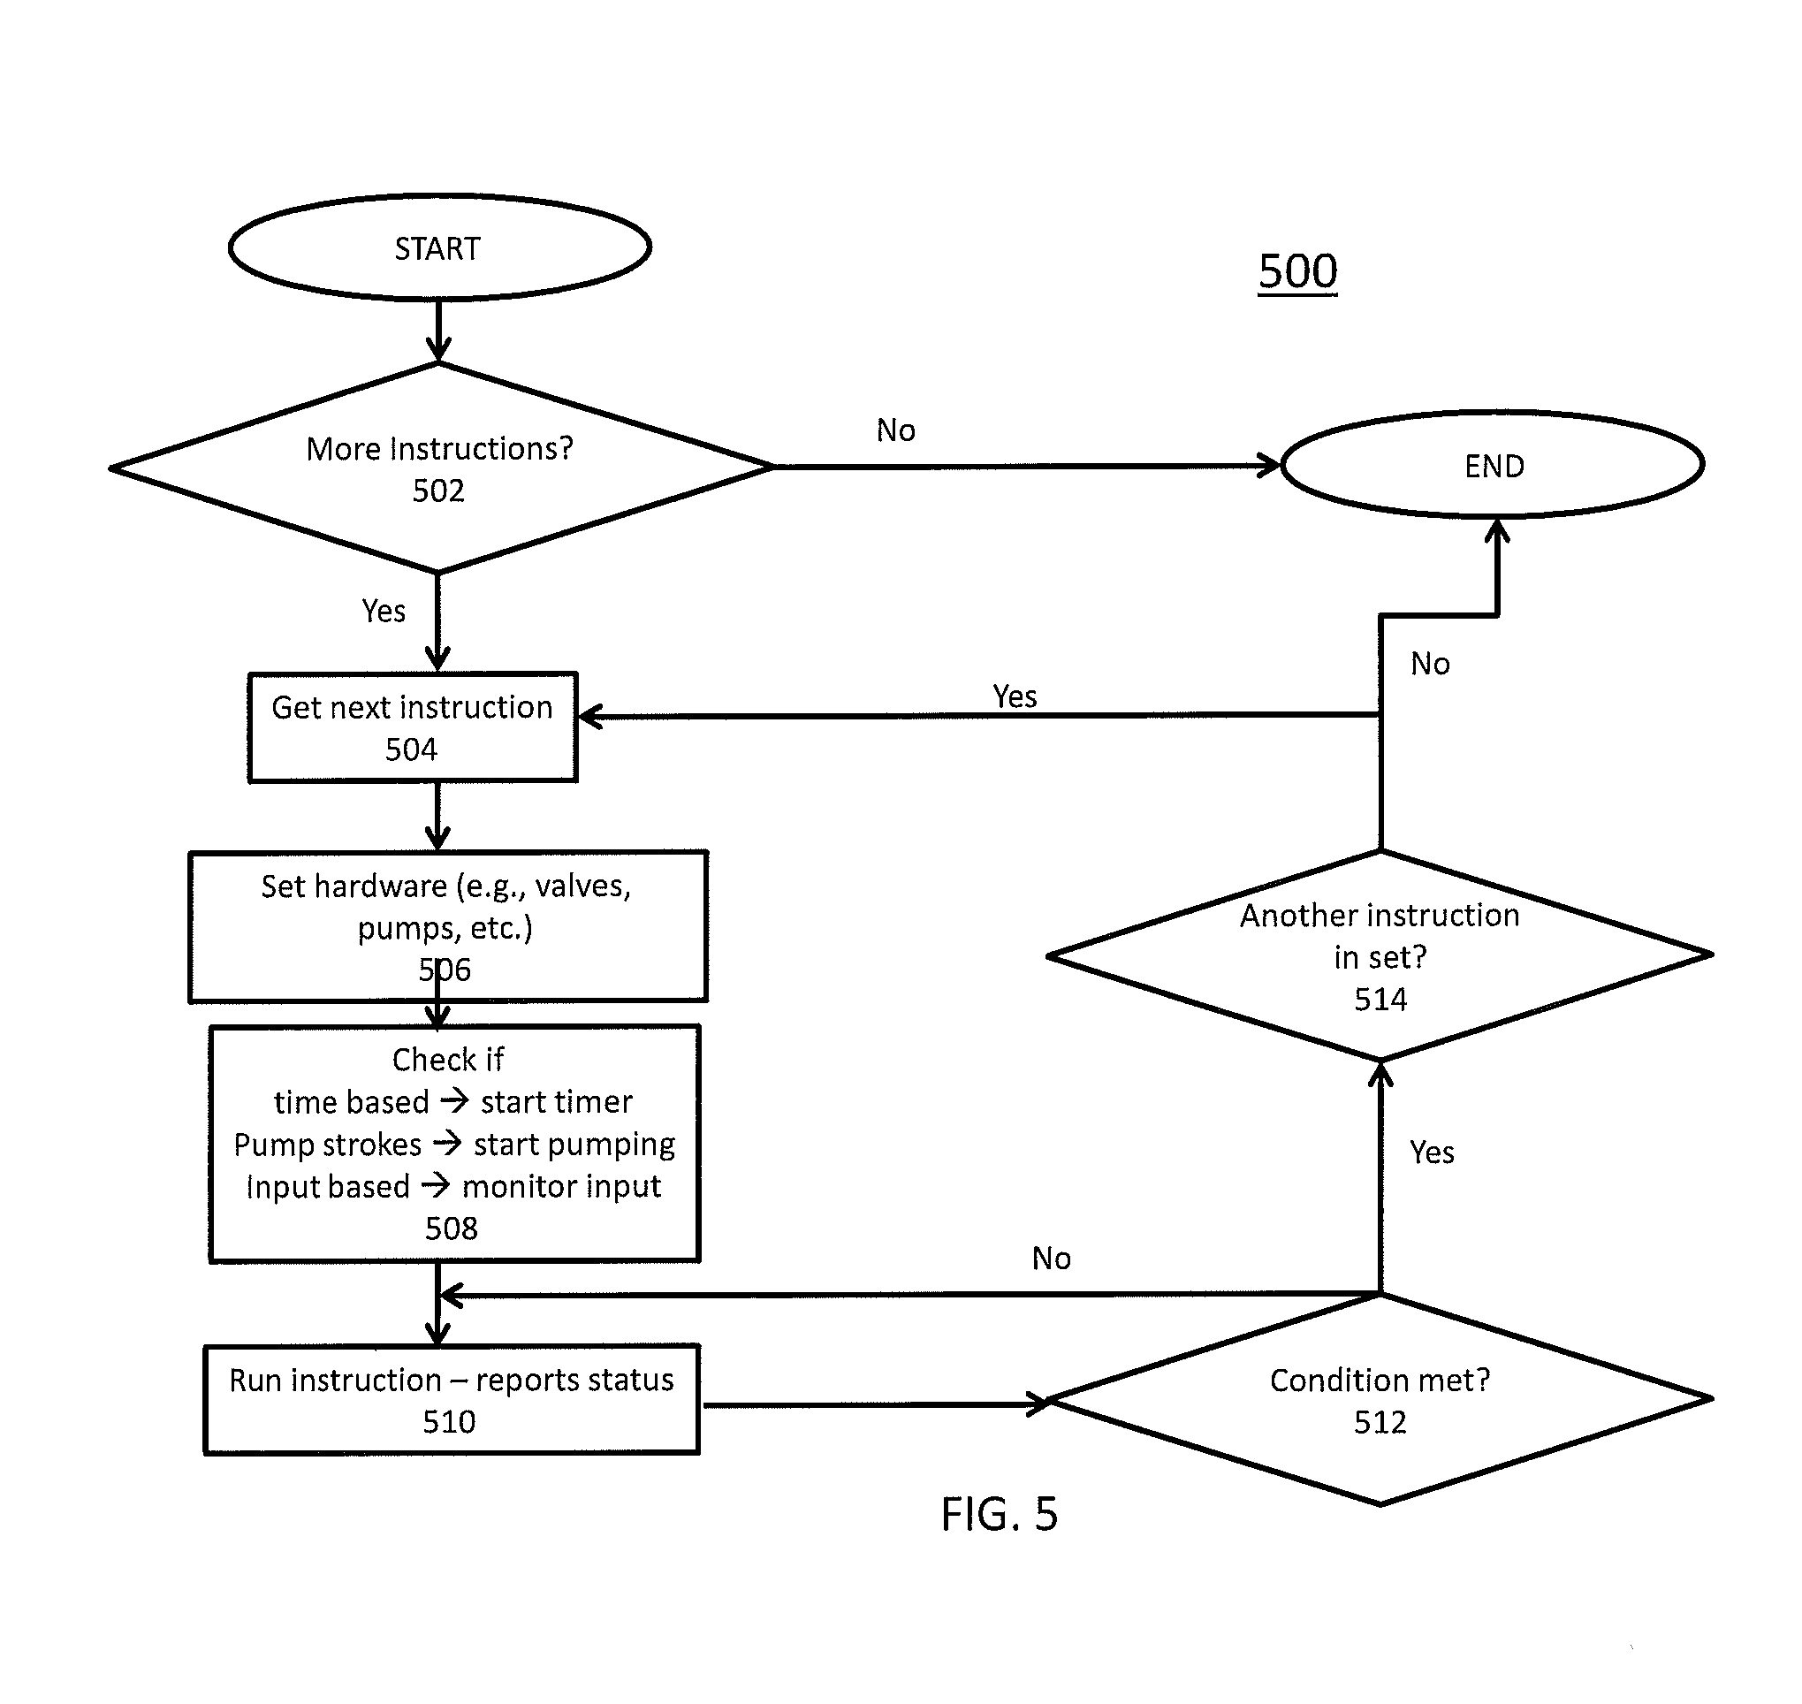
Programmable Microfluidic Systems and Related Methods – 2013
A method that allows the translation from a programming language to a set of device specific requests.
Includes a contamination mitigation method and conflict list based around system timing.
Notes:
This is the birth of an instruction set architecture for Microfluidic Devices. This system allows for a more generally programming language to be used that can then be translated to a chip specific set of instructions.
http://www.google.com/patents/US20130239082

Slide 22
Resources
http://www.ipaustralia.gov.au/get-the-right-ip/patents/about-patents/
http://www.uspto.gov/inventors/patents.jsp
http://appleinsider.com/articles/13/08/09/the-iphone-patent-wars-early-patent-skirmishes-of-apple-inc-in-pictures
http://thekneeslider.com/polaris-patent-reveals-a-side-by-side-three-wheeler/
http://ausdroid.net/2013/08/07/new-google-patent-shows-customisable-pattern-unlock-to-apps/
http://www.google.com.au/patents/US8183997
http://www.google.com/patents/USD487715#v=onepage&q&f=false
http://totallyabsurd.com/alarmfork.htm
http://www.dailymail.co.uk/sciencetech/article-2258324/The-60-smart-fork-monitor-eat--sound-alarm-overdo-dessert.html
http://www.pcauthority.com.au/News/366583,microsoft-patents-smart-bra-design-really.aspx
http://edition.cnn.com/2013/12/04/tech/innovation/microsoft-smart-bra/
http://www.google.com/patents/US6796467
http://www.google.com/patents/US8228315
http://oneherald.com.au/google-patents-smart-contact-lens-system/
http://www.google.com/patents/WO2013166377A1?cl=en
http://www.google.com/patents/US8138930
http://web.stanford.edu/class/ee380/Abstracts/071003-slides.pdf
http://www.google.com/patents/WO2004081741A2?cl=en
http://www.google.com.au/patents/US8470151
http://www.google.com/patents/US20130239082

